Slide 1
Interim Generator Interconnection Agreement
Special Studies

Slide 2

Interim Generator Interconnection Agreement (Interim GIA) Section 11A
Prior to completion of requisite Interconnection Facilities, Network Upgrades, Distribution Upgrades, or System Protection Facilities, Interconnection Customers with pending Interconnection Requests may request Interim Interconnection Service, execute an Interim Generator Interconnection Agreement (Interim GIA) and receive Interim Interconnection Service pursuant to the terms and conditions of Section 11A and the Interim GIA.
Notes:
Execution of an Interim GIA and receipt of Interim Interconnection Service is an optional procedure and will not alter the Interconnection Customer’s Interconnection Queue Position. Interim Interconnection Service may be terminated at any point that a Generating Facility with an Interconnection Request that has a higher Interconnection Queue Position goes into Commercial Operation and Transmission Provider determines that Interim Interconnection Service and Interconnection Service cannot be provided to more than one Interconnection Customer simultaneously.
Interim Availability System Impact Studies (IASIS) are performed to determine a request’s Interim Interconnection Service (IIS) available on the request’s Commercial Operation Date prior to its DISIS results. No Network Upgrades are assigned to a request via an IASIS.

Slide 3
IASIS Application/ Criteria
Request must be submitted by IC, in writing, and shall minimally include all required information per Attachment V; Section 11A.2
If an Interconnection Customer elects to proceed with Interim Interconnection Service by the end of DP2, final DISIS Phase 2 Limited Operation results may be used in place of an IASIS study if an IGIA could be put into effect before a GIA.
The request’s respective DISIS Phase 2 must not have commenced because the DISIS Phase 2 results would be available at or near the same time as the IASIS results
The expected posting of request’s DISIS Phase 2 results are after the request’s Commercial Operation Date.

Slide 4
SPP will not execute the IGIA unless the IC provides the information described in section 11A.2:
reasonable evidence of continued Site Control or posting of $250,000, non-refundable additional security, which shall be applied toward future construction costs;
reasonable evidence that one or more of the following milestones in the development of the Generating Facility, at Interconnection Customer election, has been achieved:
the execution of a contract for the supply or transportation of fuel to the Generating Facility;
the execution of a contract for the supply of cooling water to the Generating Facility;
execution of a contract for the engineering for, procurement of major equipment for, or construction of, the Generating Facility;
execution of a contract (or comparable evidence) for the sale of electric energy or capacity from the Generating Facility;
statement signed by an officer or authorized agent of the Interconnection Customer attesting the Generating Facility is included in an applicable state resource plan;
other information that the Transmission Provider deems to be reasonable evidence that the Generating Facility will qualify as a Designated Resource; or
application for an air, water, or land use permit.

Slide 5
Requirements in section 11A.2 Con’t:
Additional requirements for eligibility:
IC has met the terms and conditions to be included in SPP DISIS Queue pursuant to Section 8.2;
IC has submitted in writing to SPP a request for Interim Interconnection Service
IC has agreed to cover all costs, including deposits for any additional studies required by the Transmission Provider to assess the feasibility of its requested Interim Interconnection Service.;
The IASIS will maintain the scope and procedures of the DISIS with the exception that certain previous queued interconnection request may not be included in the study
The IASIS will also include a SCRCCT screening. When the SCRCCT screening indicates possible inverter instability, SPP will commence an EMT Study as far in advance of the requested Commercial Operation Date as practicable.
The cost of the IASIS will be subtracted from the Customer’s study deposit submitted for the DISIS.
Based on additional studies, the Transmission Provider has determined that, considering the In-Service Date and Transmission System topology, there will be enough stability and reliability margin to support Interim Interconnection Service to the Generating Facility.
IC has executed an Interim GIA in accordance with Section 11A.3; and
IC has provided security in accordance with Article 11.7 of the Interim GIA.

Slide 6
Requirements in section 11A.2 Con’t:
Additional requirements for eligibility:
Based on additional studies, the Transmission Provider has determined that, considering the In-Service Date and Transmission System topology, there will be enough stability and reliability margin to support Interim Interconnection Service to the Generating Facility.
IC has executed an Interim GIA in accordance with Section 11A.3; and
IC has provided security in accordance with Article 11.7 of the Interim GIA.

Slide 7
IASIS Process Overview
Request Initiation
Intake
Request must be submitted by IC, in writing, and shall minimally include all required information per Attachment V; Section 11A.2
SPP GI Special Studies receives the data package from the IC and performs a validation review
IASIS Study
See SPP Business Practice 7250 Section 7.3 for study methodology and analysis performed
IC Acceptance
SPP shall notify Interconnection Customer in writing whether Interim
Interconnection Service is feasible.
Feasible
SPP shall tender to the Interconnection Customer a FERC approved standard form of the drafted Interim GIA together with appendices
Section 11A.2

Slide 8
Interim GIA Process Overview
Negotiation Period
Final IGIA
Transmission Provider, Transmission Owner and Interconnection Customer shall negotiate 30 calendar days for disputed provisions of the draft IGIA
At the conclusion of the negotiation period or sooner if the Parties have reached agreement, Transmission Provider shall tender a final Interim GIA and within ten (10) Calendar Days
IC Decision
execute the tendered Interim GIA and return to the Transmission Owner and Transmission Provider; or
Transmission Owner
shall also execute the tendered Interim GIA and send a copy of the executed Interim GIA to Interconnection Customer and Transmission Provider no later than 30 calendar days
request in writing that Transmission Provider file with FERC an Interim GIA in unexecuted form
Section 11A.3

Slide 9
Commencement of Interim Interconnection Activities section 11a.4
If the Interconnection Customer signs the Interim GIA, all parties will fulfill their obligations under its terms, subject to FERC modifications. If the Interim GIA is submitted unexecuted, the parties must promptly comply with its terms, also subject to FERC modifications.

Slide 10
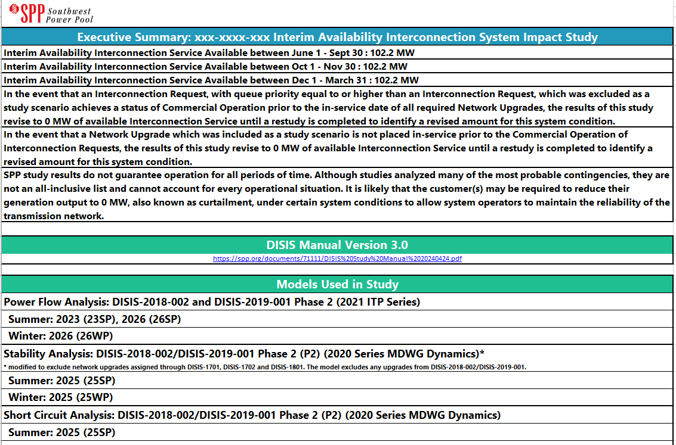
Sample Interim Report

Slide 11
Annual Interim Study
The Transmission Provider will annually perform a re-study of each effective Interim GIA per Attachment V; Section 11A.6
The Transmission Provider will annually perform a re-study of each effective Interim GIA and will determine whether the Interim Interconnection Service determined pursuant to Section 11A.2 continues to be available in the amount specified in the Interim GIA
The Transmission Provider will increase or decrease the amount of service in the Interim GIA based on the results of the annual restudy and subject to Article 4.2.3 of the Interim GIA

Slide 12
Annual Interim Study
BP7250 7.4.2
A GIR will be included in the Annual Interim Study if the following criteria is met
The GIR has an effective IGIA, and
The current special studies DISIS model set is later than the base DISIS model set used to determine the latest IIS value for the GIR, and
The GIR’s final DISIS Phase 2 results are not available

Slide 13
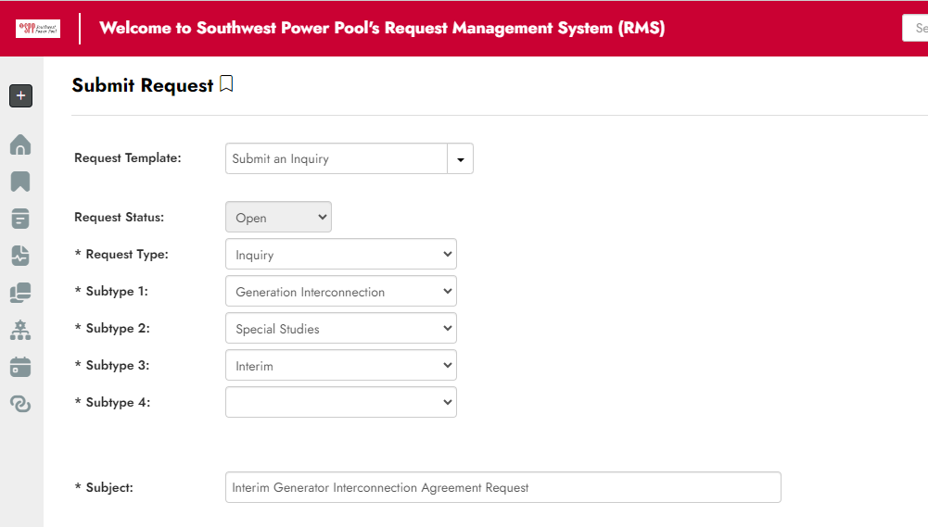
SPP Request Management System (RMS)
SPP RMS Ticket portal, select "New Request" > "Submit Inquiry" > “Inquiry" > "Generation Interconnection“ > “Special Studies" > “Interim”. This will expedite the routing of your submission

Slide 14
Questions? SPP Request Management System (RMS)

